Slide 1
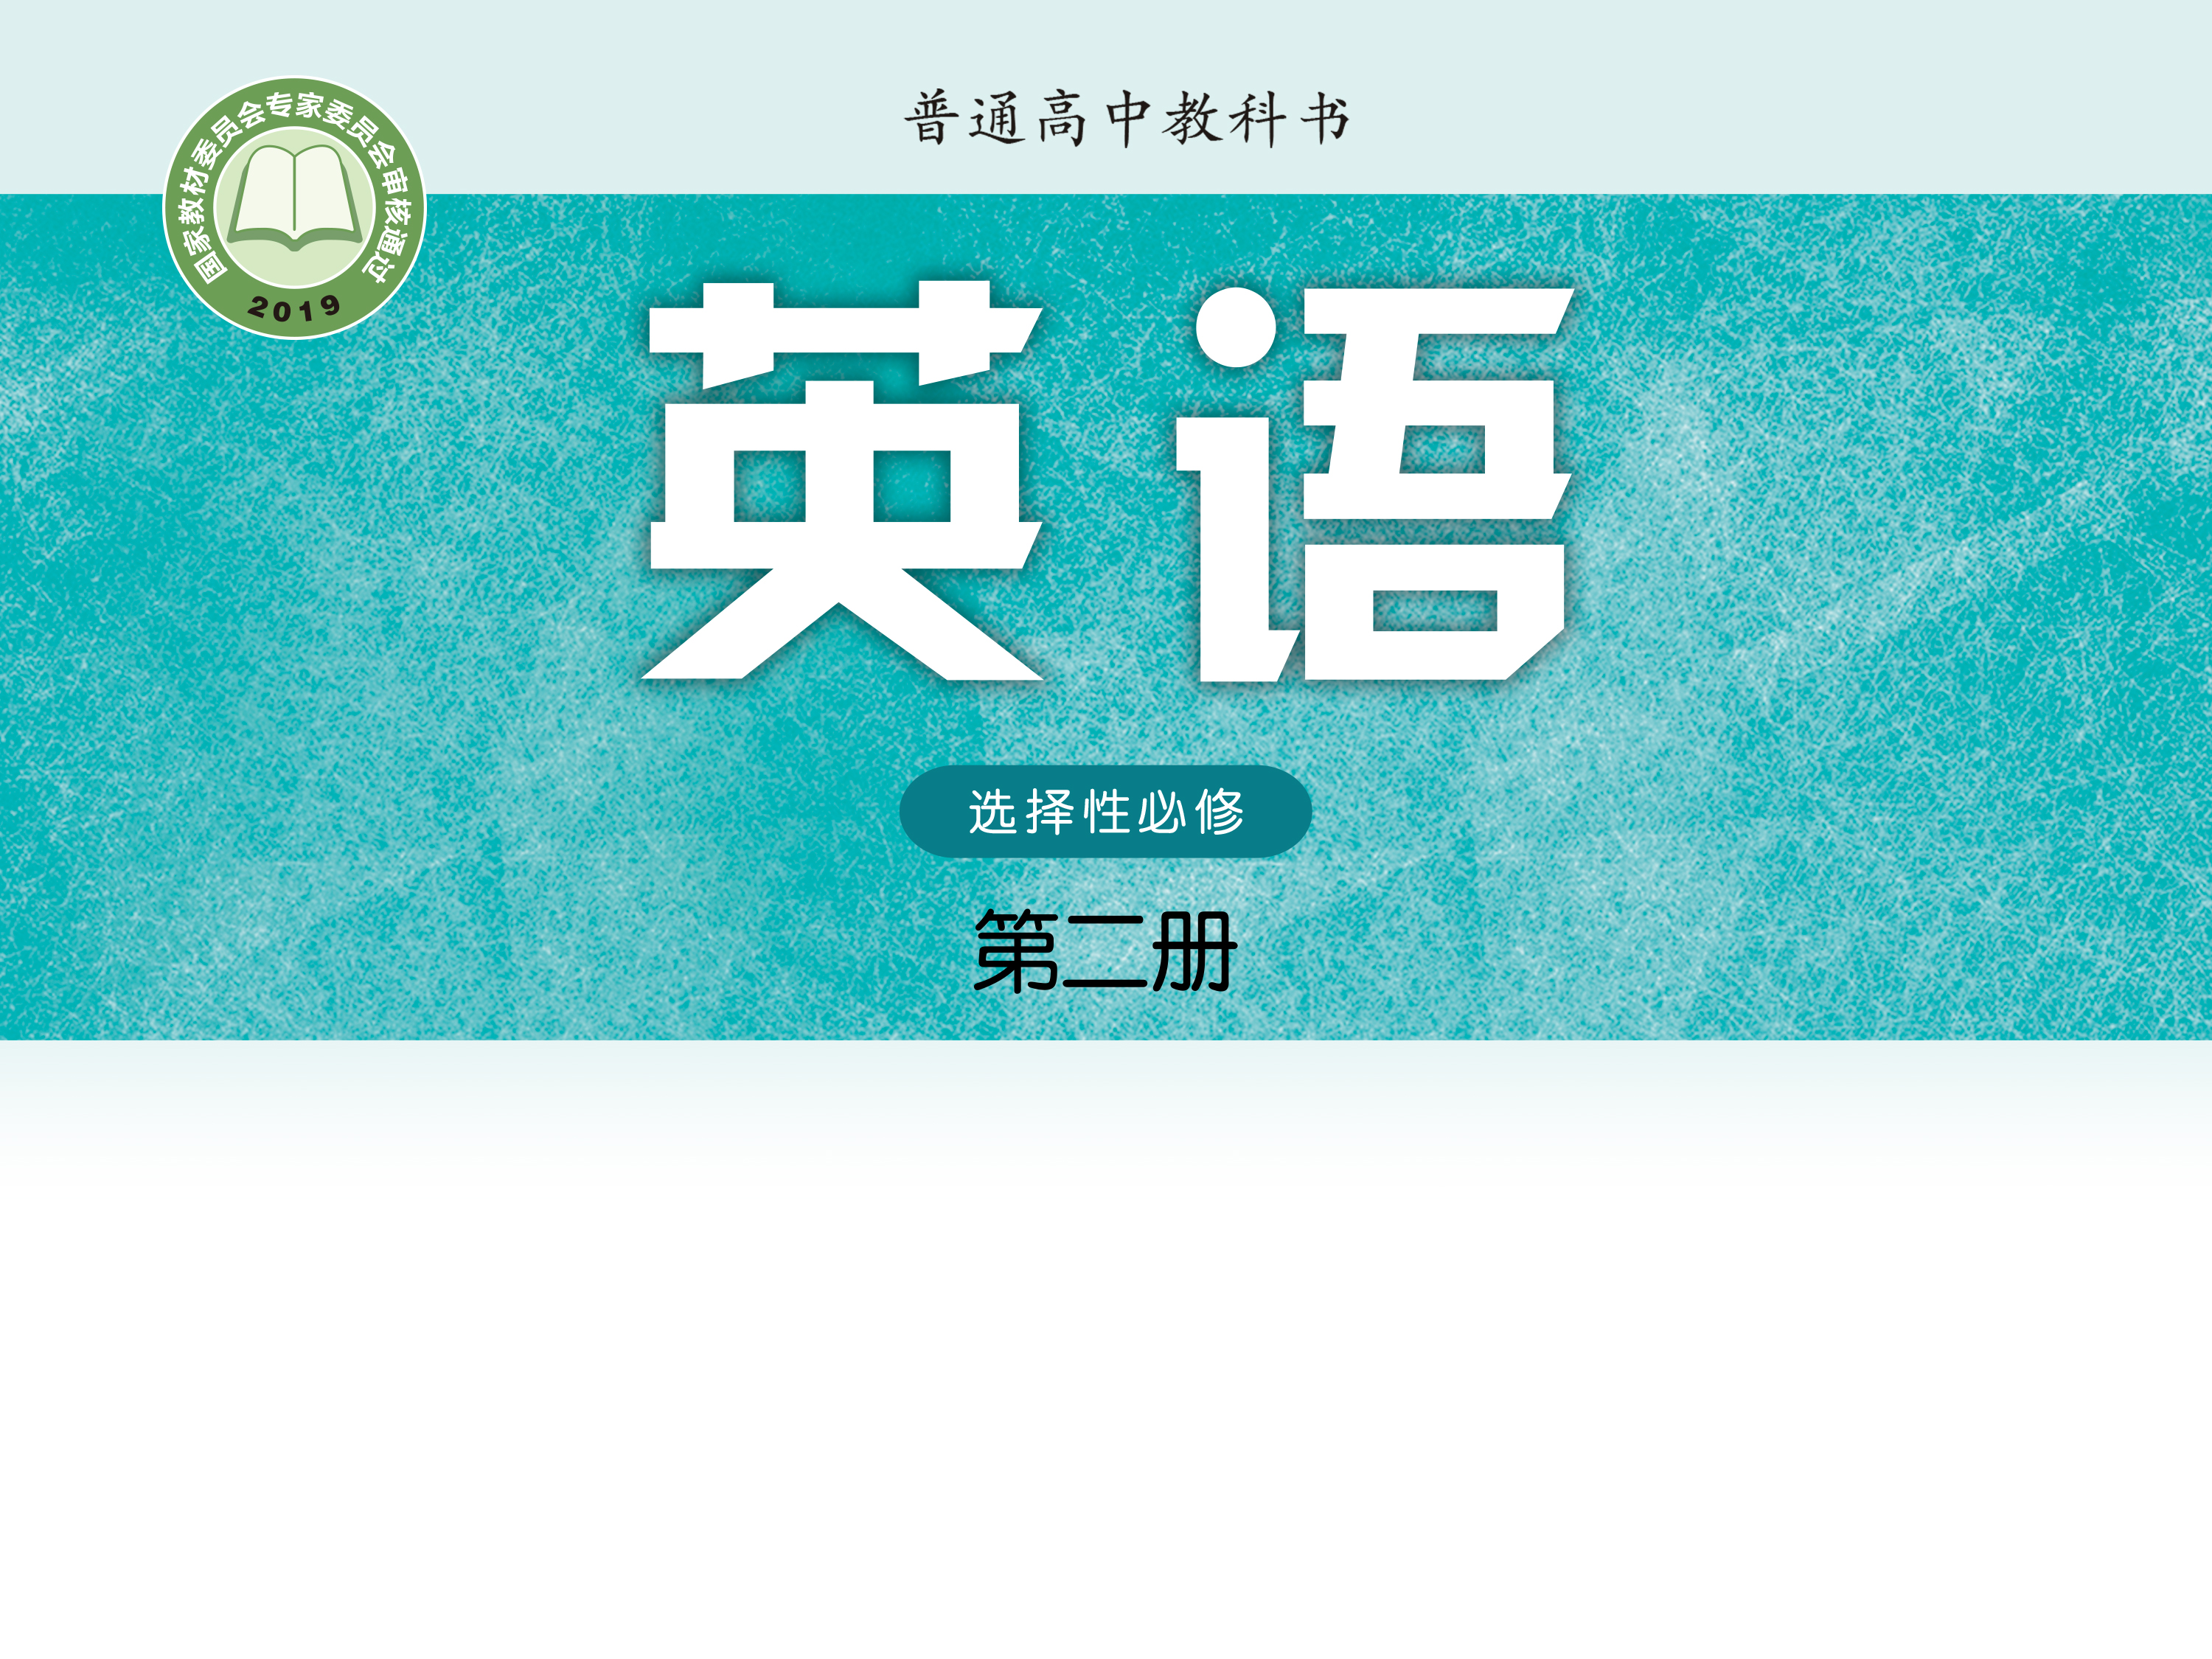
Unit 1 The mass media
Part 1 Reading

Slide 2
1
Wordlist
CONTENTS
2
Language points P2-5
3
3
Instant Feedback

Slide 3
Wordlist
1. critical adj. 批评的，批判的；关键的，紧要的
be critical of… 对…批评…
be critical to 对…至关重要
be of critical importance 极为重要
critically adv.
criticism n.批评
critic n.批评家,评论家
criticize (criticise) v.批评,评论
be criticized for因…而受到指责

Slide 4
2. trap v./n （trapped, trapped） trapping
1) be trapped in 困在, 陷在 (be caught/stuck in)
the miners _________ underground
______________________________(遇到交通堵塞), he was late for the interview.
2）trap sb.into doing...诱骗某人做……
3) fall into a trap 落入陷阱/圈套
trapped
Having been trapped in traffic

Slide 5
release vt.n 释放;发行/布/表/射/泄;免除
release prisoners/emotions/a new album 释放囚犯/发泄情感/发行新专辑
release … from …将…从…释放;免除某人的
release sb. from a debt/tax免除某人的债务/纳税义务
release sth. to …向…公布某事;对…发行某物
be/go on general release公开发行

Slide 6
4. extend v.扩建/大/展=enlarge,expand;延长/续=prolong;伸展=stretch;提供=offer;竭尽全力 → extension n.扩大延伸
1)涉及（范围）；延伸（距离）；延续（时间）
extend a house/the range 扩建房子/拓宽范围
extend a deadline/visa 延长最后期限／签证
2）extend one’s hand 伸出手
3）extend sth to sb. 向某人提供/表示
extend a warm welcome to sb.=extend sb. a warm welcome向某人表示热烈欢迎
extend one’s sincere gratitude to sb.向某人表示感谢
4）extend oneself= be fully extended竭尽全力
5） an extended/nuclear family 大/小家庭

Slide 7
construct v.建造;构思,创立 construction n.
be under construction 正在建造
constructive a.建设性的;有助益的 constructor n.建造者
destroy v.破坏;毁灭(destroyed*2) destroying
destruction n.
destructive a.破坏性的 destroyer n.破坏者;驱逐舰
6. dozen n.一打=twelve;十来个； 许多=a lot
a dozen students 12个学生
two dozen bottles of orange两打瓶装橙汁
dozens of books 很多书
sell by the dozen 成打地卖
They arrived in dozens.他们来了很多人。

Slide 8
“大量的”表格见课堂本P6
(a great/good) many, a large/great number of, quite a number of, various, a variety of + [C] pl.
much, a great deal of, a large amount of, amounts of + [U]
a lot of, lots of, plenty of, large quantities of, a large quantity of, masses of, a wealth/world of, piles of + [C] pl./ [U]
many a/ more than one+[c]单数+v.单数
7. minor a.较小/少的;次要的;轻微的
suffer minor injuries 受轻伤
major a.重要的;严重的 vi.主修+in
minority n.少数(民族) majority n.大多数;多数票
be in the minority/majority 占少/多数

Slide 9
8. bath n. 洗澡;浴缸/盆 bathe v.
have /take a bath 洗澡
bathe the wound 清洗伤口
be bathed in the sunlight 沐浴在阳光里
The sun began to rise in the sky, __________(bathe) the mountain in golden light.
__________ the brilliant sunshine, the kids played very happily.
bathing
Bathed in

Slide 10
9. scream v/n. 尖叫;高喊
scream with fear/rage/delight 吓得/愤怒/快乐地尖叫
scream in panic 惊恐地尖叫
let out a scream of terror 发出一声惊恐的尖叫
scream at sb.对某人大喊
screaming n.尖叫;尖厉的嘎吱声
adj.尖叫的;惹人注目的=striking

Slide 11
bark n.vi.吠叫,叫声;咆哮vt.厉声说出 n.树皮 vt.剥皮
bark at …对…咆哮
bark out厉声说出
be barking up the wrong tree弄错目标
11.choke vt/vi/n. (使)窒息；(使)哽咽
choke to death 窒息而死
choke with anger气得说不出话来
in a choked voice=with a choke in one’s voice声音哽咽地
choke back one’s tears强忍住泪水 =hold back/ contain
The roads were choked （up）with traffic. 堵塞

Slide 12
12. carpet n.地毯;厚厚的一层 vt.覆盖;训斥
sweep/brush/push sth. under the carpet 掩盖某事
a carpet of flowers/snow满地的花/一层厚厚的雪
The island was carpeted with flowers.布满鲜花
a pack/packet of cigarettes 一包香烟
automatic adj.自动的;不假思索的 n.自动挡
automatically adv.
automatic drive自动驾驶
an automatic response不假思索的反应
be equipped with automatic fire alarm system
配备火灾自动报警系统

Slide 13
investigate v.调查/研
investigation n. investigator n.调查者
be under investigation在调查中
make a thorough investigation 进行彻底调查
on (further) investigation经(进一步)研究
An investigation is under way.正在进行调查研究
15. journalist n.新闻记者
journalistic adj.新闻业的;新闻记者的
journalism n.新闻业;新闻报道
journal n.期刊;日/周报;日记,备忘录

Slide 14
16. come about 发生,产生
How did the contradictory information come about?
How come? 怎么会呢？
- I think she hates you？
How come? I’ve always been nice to her.

Slide 15
见课堂本P12
come across偶遇；被理解
come down to可归结为=boil down to
come down with生…病
come out出现;出版/发行；开花
come over过来;顺便来访
come to苏醒；共计；得到结果
When it comes to (doing) sth.当谈及(做)某事
come up走进;发芽；被提出
come up with提/想出；找到
come on加油！快点！得了吧！开始运行

Slide 16
priority [c] 优先事项,最重要的事 [u] 优先(权) a.享有优先权的
prioritize v.优先考虑
a top priority 头等大事,当务之急
give priority to 优先考虑
have/take priority over sth.比某事优先考虑
Education is a top priority.教育是当务之急。
During the COVID-19 epidemic, we gave priority to prevention and put safety first. 在新冠疫情期间我们预防为主，安全第一。
be prior to 在…以前; 先于; 优先于
All the arrangements should be completed prior to your departure.
所有安排都应在你离开之前完成。

Slide 17
contradict v. 1）相矛盾，相反 2）反驳，驳斥
contradict oneself自相矛盾
contradictory a. 矛盾的 be contradictory to sth.
contradiction n.矛盾;反驳 in contradiction with/to
There seems to be a contradiction between her word and action.言行似乎不一致
19. factual information 事实信息
factually adv.事实上=as a matter of fact=in fact/effect
20. for instance =for example例如

Slide 18
21. A differ from B A与B不同 differ in 在…方面不同
differ with sb. about/on/over sth.=disagree with sb.
I beg to differ.我不敢苟同。
make a(no) difference (to) 有(没有)影响，起(不起)作用
Whatever she says will not make any difference to our arrangements.
tell the difference between A and B=tell A from B
be different from … in--- 在---方面与…不同
When we come across such factual differences，we should not rush to the conclusion that one of the news reports gives false information.

Slide 19
22. conclusion n.结论 conclude v.1)结束 2)推断,断定
rush/jump to the conclusion (that ---)贸然断定…
draw/reach/come to/arrive at a conclusion 得出结论
in conclusion 总之，最后
conclude …with… / by doing sth 以…结束…
conclude (sth) from ---从…推断出
The story concludes with a happy ending.
In conclusion, I'm convinced of his honesty.
He concluded from their remarks that they contradicted the plan.
23. false information 虚假信息

Slide 20
24. bring sth to light 揭露
Thanks to the police’s investigation, these facts have been brought to light. 多亏了警察的调查，这些事实才被揭露出来。=cast light on the cause of
come to light 为人所知
light up (lit/lighted, lit/lighted; 用于名词前作定语通常用 lighted)
a lighted candle点燃的蜡烛
He lit (up) a cigarette. 他点着一支香烟。
The candle lit up the room.蜡烛照亮了房间。
A smile lit up her face. 笑容满面,喜形于色

Slide 21
25. minimum n.a.最小的;最小值 反义：maximum
the minimum wage最低工资
26. sum n.款项;总和;全部;算术 (summed, summed) summing
sum up总结,概括
a large sum of money一大笔钱
In sum, =To sum up, 总之
=In summary/conclusion=To conclude
His speech summed up the present situation of economy.
To sum up, for a healthy heart you must take regular exercise and stop smoking.= in a word, on the whole, in short/brief, all in all

Slide 22
accurate adj.准确的 inaccurate不准确的
accurately adv.精确地
accuracy n. 精确
I have been convinced that the print media are usually more accurate and more reliable than television.
我确信印刷媒体常常会比电视更准确、更可靠。
You need to check the accuracy of the relevant information.
您需要检查相关信息的准确性。
联想：words with the same suffixes -cy
fluent fluency frequent frequency
efficient efficiency private privacy
urgent urgency ...

Slide 23
28. commit oneself to doing （committed，committed）
=be committed to doing
commit v.1) 致力于…,献身于…,忠于… 2) 承诺, 保证
3) 犯commit suicide/murder/a crime 自杀/谋杀/犯罪
Though journalists are committed to presenting the truth, it is better to use our own judgment than rely entirely on news reports.
She is committed to/ commits herself to taking part in the English speech contest with me together.
committed adj.尽心尽责的;忠诚的
a committed member of the team 忠于职守的队员
commitment n.承诺;责任感;花费
make a commitment to (do/ doing) sth.承诺做某事
a financial commitment资金投入
He made a commitment to going bottle-free.他承诺不饮用瓶装水。

Slide 24
racial/gender discrimination种族/性别歧视
learn discrimination between right and wrong 学会辨别是非
discriminate v.
1) discriminate A from B/between A and B 区分，辨别 （=distinguish/differentiate)
2) discriminate against/in favor of --- 歧视，区分对待
practices that discriminate against women and in favor of men 重男轻女的做法
30. be curious about 对…好奇
out of curiosity 出于好奇
meet/satisfy/ arouse one’s curiosity 满足/激起---

Slide 25
Language points P2
Report one P2
The fire，which is thought to have started from the 8th floor，spread quickly through the tower block on Sunday night，leaving people on the upper floors trapped.
1） be thought /said/ reported to do/ have done/ be doing
Robert is said __________________(study) abroad, but I don't know what country he studied in.
He is believed ________________ (正在写)a new book.
2) 现在分词作结果状语，表示自然而然的结果
（only to do作结果状语，表示出乎意料的结果)
After school we went to the reading room to do some reading，only to be told that it was being decorated.
to have studied
to be writing

Slide 26
Language points P2
Report one P2
L5 Fear grew that the number of death could reach 5, according to ---
L9 There is concern that the construction company that built ---
L14/P3 --- rush to the conclision that ---
that 引导__同位语__从句，对名词进行解释说明。

Slide 27
Language points P2
Report one P2
L7 By this time, the fire had extended to ----
By now 5 poeple have been confirmed dead.
We will have accomplished the task by the end of this year.
By the time I got home, he had left.
总结：
By +过去时间, 主句:__had done____
By+ 现在时间, 主句:__have done____
By+将来时间, 主句:__will have done___

Slide 28
Language points P2
Report 2
L6 I was about to have a bath when I heard people screaming and dogs barking. (when =and then , 并列连词，“就在这时/突然”，时态？）
sb. be about to do/on the point of doing sth. when---正要做某事…这时（突然）
sb. be doing sth. when---正在做某事，这时（突然）
sb. had just done sth. when ---刚做完某事，这时（突然）
was driving
I ______________(drive) down to London when I suddenly found that I was on the wrong road.
He _______________(finish) his homework when his mother asked him to play the piano.
had finished

Slide 29
Language points P2
Report 2
L9 Mr peterson---- confirms that ---- and that the automatic fire alsrms did not go off quickly enough to prevent the disaster.
1) that?
2) go off 警报器发出响声，闹钟响铃，灯熄灭
I’ve set the alarm clock to go off at 6 am.
I was about to do my home work when the light went off.

Slide 30
Reading news reports critically
Structure
Part 1 (para 1)
News reports usually come with differences.
Part 2 (para2-3)
Differences between news reports may depend on how and when the news reports are written.
Part 3 (para 4)
We can become critical news readers in many ways.

Slide 31
Reading news reports critically
Q: Why do news reports differ from or even contradict each other?
•Journalists may __________________________________.
•Journalists may ___________________________________________.
•Journalists may __________________________________
__________________________________.
have different priorities
write news reports at different stages of an event
approch information they get from research or interviews differently

Slide 32
Reading news reports critically
Q：What do you think makes a critical news reader?
A news report can be genine or fake. First，Check the source of the news and decide whether it contains reliable information. What’s more, a critical news reader is aware that news reports may have different focuses, so he or she should read various reports on the same event. More importantly, a critical reader will form his or her own judgement instead of blindly trusting what is reported in the news.

Slide 33
Instant Feedback
extension
1. The e____________ of the subway will take several months.
2. They c_______________ a shelter out of fallen branches last night.
3. The police have completed their i_______________ into the accident.
4. We are faced with two apparently c______________ statements.
5. The essay contains a number of f_____________ errors.
6. They questioned the a______________ of the information in the file.
7. Borrowers should think carefully before c___________ themselves to taking on a loan.
8. He showed great d_______________ in his choice friends.
9. I ‘ve come to the c____________that he is not the right person for the job.
constructed
investigation
contradictory
factual
accuracy
committing
discrimination
conclusion

Slide 34
Instant Feedback
1. The strong wind blew away good soil，________(leave) only sand.
2. _____________________ （trap) in traffic, he was late for work.
3. His voice was __________(choke) with rage.
4. The new airport is still ___________________.（在建设中）
5. The letter wasn't addressed to me but I opened it _______ curiosity.
7. The saleswoman packed the pencils for me the dozen.
8. A boy who has good manners stands up in an ____________(不假思索地）movement when a lady enters the room.
9. You must learn to d_______________________ facts from opinions.
leaving
Having been trapped
choking
under construction
out of
by
automatic
discriminate/distinguish

Slide 36
X2 U1 P6-8

Slide 37
1. citizen n.公民,居民senior citizens 老年人
2. found v. 创建；建立 (founded,founded)
be founded on/upon sth 建立在...基础上=be based on
I have founded my novel on my personal experience.
foundation n.基础 a solid foundation 坚实的基础
lay the foundation(s) for sth.为某事打下基础(laid*2)
Careful planning laid the foundations for the nation’s economic miracle.
be/have a foundation for doing sth. 是做某事的根据
be without foundation=have no foundation
= be groundless 无事实根据
founder n. 发起人，建立人
founding fathers of the PRC 奠基人

Slide 38
3. politics n. 政治(观点) political adj. 政治的，政府的
politician n. 政客 policy n. 政策
4. accuse v. 控诉，谴责
accuse sb of sth =charge sb. with sth.因某事控诉某人
Are you accusing me of lying?
the accused 被告
A number of serious accusations have been made against her.
His administration now faces accusations of corruption.
accusation 【C】指控 He denied the accusation that ...
5. tax n.税款 v.征税 taxpayer 纳税人
pay tax (on sth.) (to sb.) (为某物)(向某人)缴税
tax sth. at 10%/ a higher rate tax sb. on sth.

Slide 39
6. mount v.登上;发起,举行;上升,增加 n.山
The children’s excitement is mounting as Christmas draws nearer.日益增加
She mounted her horse and rode off. 她骑上马走了。
He mounted the platform and began to speak to the assembled crowd.登上讲台,开始对集会的群众发表演讲。
mount an attack/campaign发动进攻／开展运动
At $6 a ticket, the cost quickly mounted up.
每张票6美元，费用一下子就增多了。

Slide 40
7. elevation n. 海拔;抬起;提高/升
The road climbs steadily to an elevation of 1,200 feet.
her sudden elevation to international stardom
=elevate sb. to the status of a star
elevate v.抬起;提高/升
take the elevator电梯/ escalator 自动扶梯
8. profession n.职业=occupation;宣称=declaration
professional adj.职业的;专业的 n.职业选手;业内人士
seek professional help
health professionals 医护专业人员
amateur adj. n.业余的(爱好者)

Slide 41
9. drama n.戏剧;戏剧性事件;激情
He watched the drama unfold from a nearby ship.他目睹了这一悲剧的发生。
Her life was full of drama.充满刺激
dramatic adj.戏剧(性)的;激动人心的
dramatically adv. 剧烈地;戏剧性地
dramatic change/effect戏剧性的变化/效果
a dramatic improvement in her condition惊人的好转
Output has increased dramatically.

Slide 42
10. scholarship n.学问;学术成就;奖学金
win a scholarship to…赢得…的奖学金
She won a full scholarship to Cambridge University.
=She went up to Cambridge on a scholarship.
scholar n.学者,奖学金获得者
11. category n.种类
fall into 3 main categories分三大类
The exhibition of 360 paintings is divided into three categories.
12. nevertheless adv.尽管如此
What you said was true. It was, nevertheless, a little unkind.
thanks nevertheless尽管如此,还是多谢了

Slide 43
13.witness n.目击者(witnesses);证人;证明 v.目睹见证表明
be (a) witness to sth.是…的目击者;证明某事物
The police were looking for the witnesses to the accident.
Several passers-by claimed _to have witnessed_ the attack.
Recent years have witnessed the collapse of the steel industry. （无灵主语）近年来人们的社会流动性越来越大。
Hangzhou has witnessed the 19th Asian Games.
His name slips my mind.他的名字闪过我的脑海
A good idea suddenly strikes me.我突然想到一个好主意

Slide 44
14. edition n.版本;一份/册
bring out/ issue an edition发行一版
the revised edition修订版
edit n.v.编辑 editor n.编辑
The textbook was first published in 1858 and is now in its 39th edition.
15. provide a platform for sb.为某人提供一个平台

Slide 45
16. spring up (sprang, sprung)跃起;涌现
Fast-food restaurants are springing up all over town.
Tears sprang to her eyes.眼泪夺眶而出
spring to one’s feet/ lips立刻站起来/脱口而出
spring to mind 突然在脑海中闪现
spring into life/action突然活跃起来
spring n.春天;跳跃;弹簧;泉

Slide 46
17. interaction n.交流;相互作用
interact with与…相互作用
interactive adj.交互的,相互作用的
the complex interaction between mind and body
interactive teaching methods
18. membership n.会员资格/人数;会费
I forgot to renew my membership in the sailing club.延长会员资格
The club has a membership of 200.

Slide 47
19. chart n. v.图表;绘制…的地图
a chart showing last year’s sales
Lady Gaga again topped the charts.每周排行榜首位
Her new single went straight to number one in the pop charts.
chart temperature changes/ the coast
20. broadcast n.v.广播;播放;散布(broadcast*2)
broadcast sth. to...向…广播
broadcast sth. by/on CCTV-5 通过…广播
CCTV’s/ a live broadcast of the interview现场直播
The interview was broadcast live across the world.

Slide 48
X2U1
Extended reading
& Project
p.11-13

Slide 49
1. advertising 【U】 广告业；广告活动
advertisement 【C】 (=ad) 广告
put an advertisement in “The Morning News”/ on TV
advertise v.做广告;征聘;宣传
advertise for a secretary 征聘
a poster advertising the concert

Slide 50
2. persuasion n.说服 persuade v. persuasive adj.有说服力的
persuade sb. to do=persuade sb. into doing说服某人做某事
persuade sb. not to do=persuade sb. out of doing说服某人不要做某事
persuade/convince sb. of sth说服某人相信
persuade sb. that sb. (should) do sth.
persuasive/convincing arguments/evidence令人信服的论点/证据
a persuasive speaker有说服力的演讲者
While shopping, people sometimes can’t help _being persuaded into buying something they don’t really need.
说而不服 try to persuade sb. …/ advise sb. to do …
I tried to persuade him to give up smoking.

Slide 51
3. channel n.电视台;途径,渠道;方式,手段;水道v.输送;提供帮助
change/switch channels换台through proper channels通过正当的途径
a useful channel of communication between A and B沟通的有益渠道
a channel for releasing one’s emotions宣泄情感的好方法
4. peak n. adj. v.山顶/峰;最高/佳的;达到最高峰
at one’s peak 在...的全盛期
She’s at the peak of her career.
Subway is always crowded at peak times.高峰期
snow-capped mountain peaks 山顶
reach the summit of Mount Everest 顶峰
Sales peaked in August, and then fell sharply.达到最高值

Slide 52
5. boost vt. n.促进;增加
Winning the prize boosted one’s confidence/spirits.增强某人的自信心/士气
The new resort area has boosted tourism.
a boost in sales销售额增加
6. psychology n.心理学 psychologist n.心理学家
psychological adj.心理学的 psychologically adv.

Slide 53
7. purchase vt. n.购买
Tickets can be purchased in advance from the box office.
She made two purchases from my stall(摊位).
make a purchase采购
purchaser n. 购物者 purchasing power 购买力
8. memorable adj.难忘的;值得纪念的=unforgettable
We want to make this a truly memorable day for the children.
memorize/ memorise v.记住
in memory of纪念
memorial n.纪念碑/物

Slide 54
9. get ... across (to sb.)到对面;传达;把…讲清楚
I spoke slowly, but my meaning didn’t get across.被理解
It’s important that we get this message across to the voters.把......讲清楚
get over克服;恢复get about/around流传传播
get through 通过,到达,完成,接通电话;熬过
get away with携带…溜走；逃脱…的惩罚
get down to下降到；着手处理+doing sth.
get together聚会；收集；组织
get on/along with相处;进展

Slide 55
用适当的介词或副词填空
It is not a serious illness, and she will soon get _over_ it.
News soon got __around/about__ that he had resigned.
3) He was followed by a group of reporters trying to get _down_ every word he said.
4)I tried calling you several times but I couldn’t get _through_.
5) Do you get _along_ well with your new classmates?
6) I have tried to get my point _across_.

Slide 56
10. brand n.v.品牌;烙印
protect one’s brand image品牌形象
a brand-new car 崭新的
11. He has been appointed British ambassador to the UN.
大使
12. the placement of children in foster homes
将儿童安置到寄养家庭

Slide 57
13. rating n.等级;评分 rating收视/听率
TV shows with high ratings 高收视率
the unemployment rate 失业率
Children learn at different rates. rate n. 速度，速率
At this/that rate we won’t ever be able to afford a holiday.
照此/那种情形;以这/那一速度
They’ve had technical problems--at any rate that’s what they told me. 无论如何anyway,不管怎么说
The show was rated as a success by critics.评价某人/某物
14. sponsor vt.资助 n.赞助者
These sports events are sponsored by the same company.被赞助
government-sponsored projects a major sponsor of the Olympics

Slide 58
15. absorb vt.吸收; 理解 absorption n.吸收
absorb/take in light/heat/oxygen/knowledge吸收理解掌握
be absorbed in doing全神贯注=absorb oneself in
This work has absorbed him for several years.
________ in their game, they didn’t feel hungry at all.
So absorbed were they in their games that they didn’t feel hungry at all.
全神贯注于,专心于:
be lost/buried in, be devoted to doing sth.,
focus/concentrate on, put one’s heart into, apply oneself to
Absorbed

Slide 59
一句多译: 他集中精力学习。pay attention to
(1)___________________________________________________ (focus／fix)
(2)________________________________ (absorb)
(3)____________________________________________________ (apply)
(4)__________________________________________________ (concentrate)
He focused/fixed his attention on his study.
He was absorbed in his study.
He applied himself to his study.
He concentrated (his attention) on his study.

Slide 60
16.discount 【C】 折扣
give/offer sb. a discount给予折扣 get/receive a discount得到折扣
Members get a 15% discount.八五折
Employees can buy books at a discount.打折地
17. tailor vt. 专门制作，定做 n.裁缝
tailor sth. for sb/sth为…定制
tailor sth. to sth.= be tailored to sth.根据…定制
at the tailor’s在裁缝店
The suit was well tailored. 剪裁得很精细
be tailored to one’s needs/taste 根据个人的需求/口味量身定制
The classes are tailored to learners’ needs.专门制作…以满足学习者的需要

Slide 61
18. brighten up 变亮;改善
She bought some flowers to brighten up the room.使房间亮丽生色
His letter brightened up my day.使我的一天充满了快乐
He brightened up at their words of encouragement.听到他们鼓励的话，他高兴起来。
19. housing estate 住宅区/群
He made a fortune in real estate.房地产

Slide 62
break up拆散,分解;破裂;结束 bring up抚养;呕吐;提出;提高;
build up建立;逐步积累 clear up整理,收拾,放晴
come up长出;出现;走近;被提及
draw up草拟 fix up修理 hold up阻止 choke up堵塞住
make up构成;编造;化妆; +for弥补
pack up收拾行李;停止,结束 pick up拾起,偶然学会,用车来接
pull up停车 put up搭起,住宿;张贴 set up开办;设立
split up分手;解散 spring up涌现
take up开始从事;占据 turn up调高;出现

Slide 63
20. amuse vt.逗笑
The children amused themselves by playing hide-and-seek games. 以…自得其乐
The little boy was amused at/by_ what he saw in the zoo. 以…为乐
There were puzzles and games to keep the children amused.
I don’t find his jokes amusing at all.
an amused smile/look/expression逗乐的微笑/神情/表情
to one’s amusement令某人感到好笑的是
watch in/with amusement津津有味地 amusement park 游乐园__________, in the past year many people have suggested that the BRICS story is over.可笑的是
Amusingly

Slide 64
consolidation

Slide 65
1. You should a_______ for someone in the newspaper to look after the house while we’re away.
2. He is used to having his clothes made by that______ （裁缝）．
3. China has always been a key s _________ of keeping the East Asia stable and peaceful.
4. A(n) ______________(大使) is an important representative from a foreign country.
5. He studied philosophy and ______________at Cambridge. He learns that abuse can lead to both ____________ and emotional problems and a ______________ disturbed person can’t control his behaviour.
advertise
tailor
sponsor
ambassador
psychology
psychological
psychologically

Slide 66
6. Traffic reaches a ______ between 8 and 9 in the morning．
7. Its 3-D cinemas and giant movie screens provide __________ (崭新) experiences of the earth and beyond.
8. Going to Hawaii with my sister was one of my most enjoyable and m___________ vacations.
9. You can change the c_______ if you don’t like the program.
10. He recommended that I p_________ an English dictionary to improve my vocabulary.
peak
brand-new
memorable
channel
purchase

Slide 67
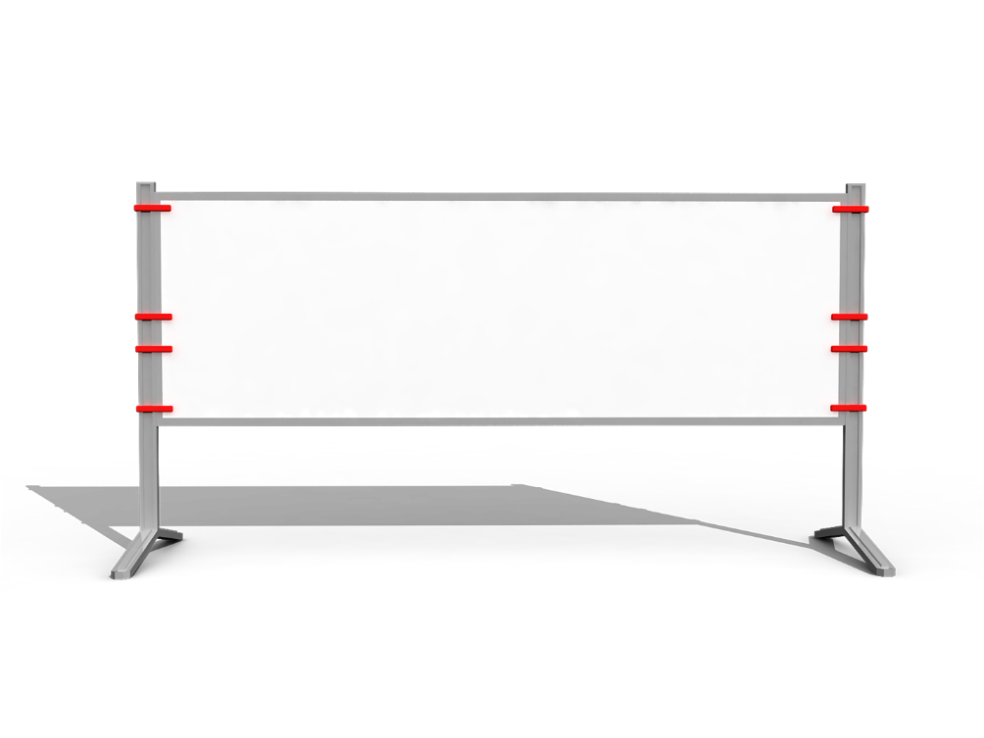
Structure
Advertising
Part 1(P1,2) Part 2(P3~6) Part 3(P7)
introduction
ways
summary
simple __________ ______ of persuading _________
__________
history
mass media
a _________ slogan
a “brand __________”
product _________
definition
memorable
ambassador
placement

Slide 68

grow-grew-grown
As media channels have grown in number and type, so have advertisements.
随着媒体渠道数量的增加和类型的丰富，广告也在不断发展。
(Just)as...,so...
正如......, ...... 也一样
As you sow, so will you reap. /You reap what you sow.
种瓜得瓜，种豆得豆。
Just as the French love their wine, so the English love their beer. (so从句中也可以不到装)
c.f. She is fond of English,and so am I.

Slide 69
raise one’s awareness
In addition to making people aware of a product or service, a successful advertisement will also create a desire to buy, thus boosting business.
一则成功的广告除了让人们知晓一种产品或服务外，还会激发购买欲，从而增加销售量。广告的历史一直以来都与大众媒体的历史息息相关。
desire vt. n.
The hotel has everything you could possibly desire.
Everyone desires to succeed.
Everyone has a desire for success/to succeed.

